Slide 1
INFO 341 Router and Routing Basics
By
Bob Larson

Slide 2
Topics Covered
What is a Router?
What are the Router’s Roles?
What is a Route Table?
What are the Router Processes?
Directly Connected Networks
Static Routes
Default Routes (form of Static route)
What is a Routed Protocol?
What is a Routing Protocol?
Categories of Routing Protocols
Static vs. Dynamic Routing

Slide 3



What is a Router?
Public Network (Public IPs) WAN
Connects two or more networks
Forwards traffic between the networks
At the edge Router or Firewall
Connects LAN(s) to the outside world
Is the Default Gateway out of the network
Within the LAN Router or Layer 3 switch
Switch can segment a network (VLANs)
Allows network segments to communicate
Network routers can exchange route info
Bigger networks or multiple locations
Only learns the organizations networks
Not the Internet or ISPs
Involves a routing protocol like OSPF
Web Server
Internet
1.1.1.10
Email Server
Web Server
.9
1.2.2.2
DMZ
.10
Router or Firewall
.115
.180
10.0.0.1/24
.111
.5
File Server
Switch
.159
.6
Web Server
WiFi Access Point
Company LAN
.100
.121
.113
.170
LAN – Private Network (Private IPs)

Slide 4
What are the Router’s Roles?
Public Network (Public IPs) WAN
Web Server
Forward data packets between networks
By having at least two interfaces in different networks
As data packet comes in one of the interfaces
Router reads the destination IP address
Using info from its route table
It forwards packet to the next router
Packet is forwarded router to router until it reaches its destination
Provides a broadcast and IP address boundary
While switches forward broadcasts, routers don’t
It is the gateway or edge of the network
All LAN hosts send packets through it to outside
It should never have the same network connected to two interfaces
Internet
1.1.1.10
Email Server
Web Server
.9
1.2.2.2
DMZ
.10
Router or Firewall
.115
.180
10.0.0.1/24
.111
.5
File Server
Switch
.159
.6
Web Server
WiFi Access Point
Company LAN
.100
.121
.113
.170
LAN – Private Network (Private IPs)

Slide 5
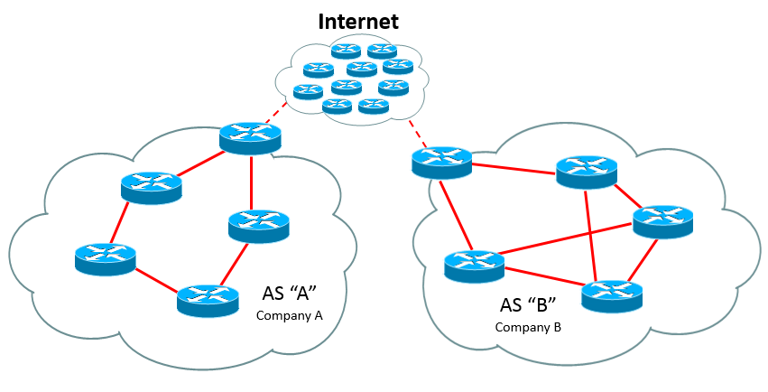
What is a Route Table?
Router1#show ip route Codes: C - connected, S - static, R - RIP, M - mobile, B - BGP D - EIGRP, EX - EIGRP external, O - OSPF, IA - OSPF inter area N1 - OSPF NSSA external type 1, N2 - OSPF NSSA external type 2 E1 - OSPF external type 1, E2 - OSPF external type 2 i - IS-IS, su - IS-IS summary, L1 - IS-IS level-1, L2 - IS-IS level-2 ia - IS-IS inter area, * - candidate default, U - per-user static route o - ODR, P - periodic downloaded static route Gateway of last resort is not set D 192.168.11.0/24 [90/284160] via 192.168.1.1, 00:04:19, FastEthernet0/0 O 192.168.10.0/24 [110/11] via 192.168.2.1, 00:01:01, s0/0 R 192.168.9.0/24 [120/1] via 192.168.4.1, 00:00:07, s0/1 C 192.168.5.0/24 is directly connected, FastEthernet0/1 C 192.168.1.0/24 is directly connected, FastEthernet0/0 S 192.168.3.0/24 [1/0] via 192.168.1.1
Legend
All Known Networks
A directory of all the organization’s networks known to the router
Only the best path to each network is included
Traffic to any unknown networks is discarded
1st column letter indicates how it was learned (added)
C – is a directly connected network
S – is a Static route
O – learned via OSPF routing protocol (use the legend)

Slide 6
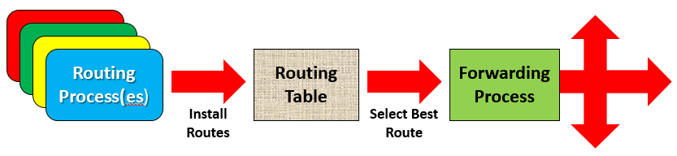
What are the Router Processes?
To build the Routing Table (Routing Process)
Each routing protocol (if more than one) uses metrics to select best route to each known network
Administrative Distance is used to decide if more than one method offers a route to same network
Methods are Directly Connected, Static and Routing Protocols
Longest prefix goes in first
To use the Routing Table (Forwarding Process)
Forwarding process requests routes from Route Table
First match in table is selected
If no match, the packet is discarded
Forwarding process builds OSI Layer 3 header and forwards to Layer 2

Slide 7
Route Table Details
1
2
3
4/5
6
7
8
D 192.168.11.0/24 [90/284160] via 192.168.1.1, 00:04:19, FastEthernet0/0 O 192.168.10.0/24 [110/11] via 192.168.2.1, 00:01:01, serial0/0 R 192.168.9.0/24 [120/1] via 192.168.4.1, 00:00:07, serial0/1 C 192.168.5.0/24 is directly connected, FastEthernet0/1 C 192.168.1.0/24 is directly connected, FastEthernet0/0 S 192.168.3.0/24 [1/0] via 192.168.1.1
Source code – how was the route learned (added)
Network Address of a known network
Prefix Mask indicating the size of the network. 1st one is 24-bits or 255.255.255.0
Administrative Distance (AD) – indicates trust level, smaller numbers more trusted
Note C (directly connected has an AD of 0, most trusted, and no metric)
If there were two routes to 192.168.11.0 from different protocols, this one was trusted more and used
Metric used by the route method in column 1 – not relevant to compare to others
If there were two routes to 192.168.11.0 using same protocol (D EIGRP), this one had smallest metric
Next-Hop router address traffic has to go to, to get to the destination network
It means that adjacent router knows how to get to the destination and will forward the packet
How long since the last routing update – relevance depends on routing protocol
Routes can be dropped if too long since last update on some like RIP
Longer times indicates route stability for Link State protocols like OSPF
Interface on this router it goes to the get to the next-hop
Static is like a direct order, i.e. follow the path to 192.168.1.1 and the next device will forward you

Slide 8
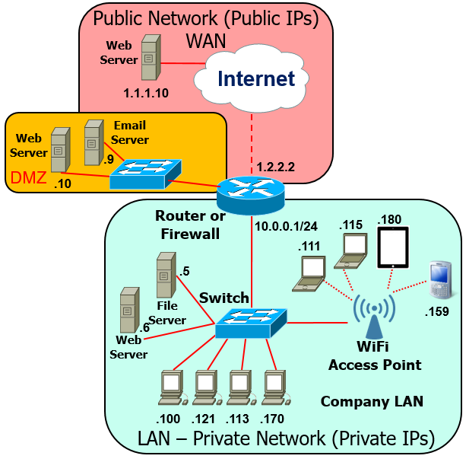
Directly Connected Networks
D 192.168.11.0/24 [90/284160] via 192.168.1.1, 00:04:19, FastEthernet0/0 O 192.168.10.0/24 [110/11] via 192.168.2.1, 00:01:01, serial0/0 R 192.168.9.0/24 [120/1] via 192.168.4.1, 00:00:07, serial0/1 C 192.168.5.0/24 is directly connected, FastEthernet0/1 C 192.168.1.0/24 is directly connected, FastEthernet0/0 S 192.168.3.0/24 [1/0] via 192.168.1.1
They are all local networks for the router
No route configuration required, as long as:
The interface is properly configured
Not shut down, and
Connected to a live link (Ethernet or serial device)
No routing protocol (OSPF) used
Since they appear in the table we know:
They are directly connected (local) networks
Which interface they are connected to
We can send packets to those networks

Slide 9
Static Routes
D 192.168.11.0/24 [90/284160] via 192.168.1.1, 00:04:19, FastEthernet0/0 O 192.168.10.0/24 [110/11] via 192.168.2.1, 00:01:01, serial0/0 R 192.168.9.0/24 [120/1] via 192.168.4.1, 00:00:07, serial0/1 C 192.168.5.0/24 is directly connected, FastEthernet0/1 C 192.168.1.0/24 is directly connected, FastEthernet0/0 S 192.168.3.0/24 [1/0] via 192.168.1.1
Manually configured by Admin
The syntax is:
ip route dest-ip-addr dest-mask [next-hop-ip | outbound-interface]
Two examples:
ip route 192.168.3.0 255.255.255.0 192.168.1.1 (next-hop-ip)
ip route 192.168.3.0 255.255.255.0 Fa0/0 (outbound-interface)
Because of AD (1) can be used to over-rule learned route
Example: All traffic for network 192.168.3.0/24 will be sent via the router at 192.168.1.1
Only appears if link to 192.168.1.1 is in the table (up)

Slide 10
Default Routes (form of Static route)
Means none was created
Gateway of last resort is not set
D 192.168.11.0/24 [90/284160] via 192.168.1.1, 00:04:19, FastEthernet0/0 O 192.168.10.0/24 [110/11] via 192.168.2.1, 00:01:01, serial0/0
Before:
Small networks have directly connected and a Default route
Important static route, or gateway of last resort
Used to forward traffic for all unknown networks
Usually to the ISP, who will forward or discard
It means our routers only need to know about our networks
Manually configured by Admin
The syntax is: 0.0.0.0 (any network) 0.0.0.0 (any mask)
ip route 0.0.0.0 0.0.0.0 [next-hop-ip | outbound-interface]
Two examples:
ip route 0.0.0.0 0.0.0.0 10.1.0.2 (next-hop-ip)
ip route 0.0.0.0 0.0.0.0 s0/1 (outbound-interface)*
Because of AD (1) can be used to over-rule learned route
Gateway of last resort is 10.1.0.2 to network 0.0.0.0 C 10.1.0.0/30 is directly connected, s0/1 S* 0.0.0.0/0 [1/0] via 10.1.0.2
After:
Always the last entry
* Should be used only with point-to-point connections, which is the norm for ISP connections.

Slide 11
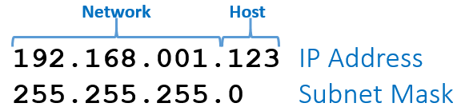
What is a Routed Protocol?
Also referred to as routable protocol
Refer to data and address protocols
The addresses have a network ID
Tells where to find the host (What network)
IPv4 and IPv6 are examples
Earlier protocols had no network ID
Only identified host in a broadcast domain
Ethernet and MAC addresses are examples
Earlier ones used host (computer) names

Slide 12
What is a Routing Protocol?
Used by routers to exchange network info
How routers learn where networks can be reached
Can quickly adapt to network changes
New networks or link outages
Dynamic alternative to Static routing
Routes manually configured by an Admin
Must be reconfigured with every network change
Must be done before router can forward data
Does not forward data
It provides the map routers use to forward data
It allows Routed (routable) data to be forwarded

Slide 13
Categories of Routing Protocols
Could be BGP or Static Route
Interior Gateway Protocol (IGP)
Used within an Autonomous System (AS)
AS is a company (Boeing) or organization (UW or US Army)
Many examples RIP, OSPF, EIGRP, etc.
Exterior Gateway Protocol (EGP)
Used within the Internet (Backbone)
Only one Border Gateway Protocol (BGP)
Only big AS can get direct BGP connection

Slide 14
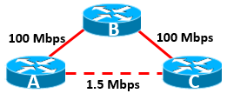
Types of IGPs
Distance Vector Protocols (example RIP)
Original, older, routing protocols
Measured distance in hop counts (metric)
How many routers to the destination
Smaller the hop count always chosen (A>C over A>B>C)
Ignored link speed (bandwidth)
Link State Protocols (example OSPF)
Uses metrics that factor in bandwidth
Smallest metric chosen, fastest route (A>B>C over A>C)
Less likely to pick a sub-optimal route
Converges faster than DV after network changes
All routers agree on changes and ready to forward data

Slide 15
Static vs. Dynamic Routing
Benefits of static routing include:
Less overhead on the router’s CPU
No need to compute routes for the table
No bandwidth usage – No route advertisements need to be sent
Critical on low bandwidth links like serial T1s or Satellite links
On backup links – Only appear when link is up. Don’t keep link up.
Improved granularity more detailed control over route selection
Security – routes can’t be tampered with by outsiders
Disadvantages of static routing include:
Changes are labor intensive – a manual process
Doesn’t scale well – Larger the network, the more difficult it is
More Layer 3 devices, the more difficult static routing becomes
Fault tolerance / fail-over becomes tricky
Requires a thorough understanding of the network by Admin
Disruptive outages can hurt performance and hard to work-around

Slide 16
Fin…

